Slide 1
Exploring Generative AI Tools for Research and Academia
Miranda Axworthy, Reference & Teaching Resources Librarian
Susan Currier, Faculty Librarian

Slide 2
Welcome!
What AI tools have you used in your research?
What are your hopes and concerns?
Where do you think AI belongs in research?

Slide 3
Navigating Information Overload
Information overload has gotten more extreme, but it's nothing new!
Can't read (or even search) everything, track retractions...
Gen AI can go through far more than we can

Slide 4
Equity
The "Matthew effect" (Craft-Morgan, 2024; Teixeira Da Silva, 2021)
Will AI improve equity or enhance inequity?
Image Source: Tapan Desai

Slide 5
Some AI Considerations
Check privacy policies and terms of use
Beware hallucinations
Know why you are using a given tool
Compare results and reflect

Slide 6
Demonstrations
Semantic Scholar: https://www.semanticscholar.org
Research Rabbit: https://www.researchrabbit.ai/
Keenious: https://keenious.com/

Slide 7
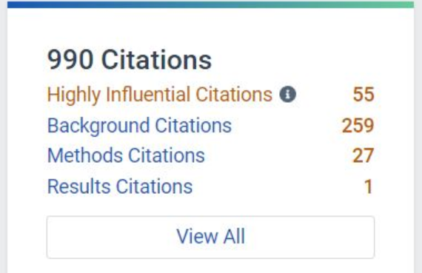
Semantic Scholar http://www.semanticscholar.org
AI-powered research and discovery tool
Free and Open
Covers all STM and SSH disciplines
At the article level:
Powerful filter and sort functions
Most relevant authors highlighted
Quick actions at the article level like citation counts, classifications and influence indicators.

Slide 8
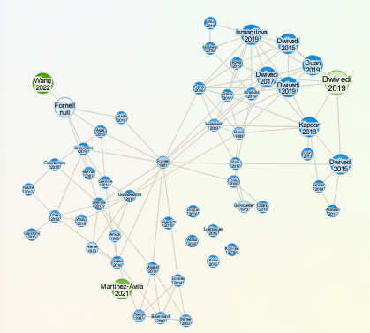
Research Rabbit https://www.researchrabbit.ai/
AI-powered discovery tool
Free
Pulls articles from PubMed and Semantic Scholar
Creates visualizations of citation and author networks
Suggests similar articles based on what's already in your collection
Share collections with collaborators

Slide 9
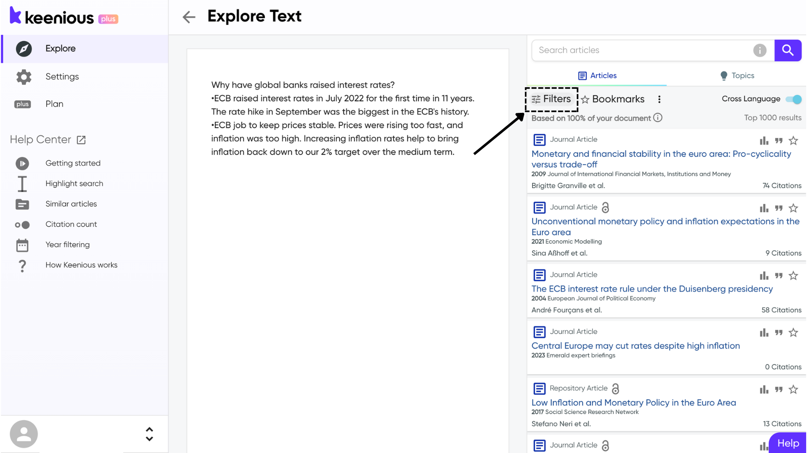
Keenious https://keenious.com/
AI-powered discovery based on text analysis
Freemium
Draws from OpenAlex dataset
Analyzes your document to recommend relevant research
Curates research organized into "topics" related to your document
Basic (free) account limits length of text (up to 1000 words), number of results (top 10... kind of)

Slide 10
Explore on your own!

Slide 11
Debrief
What did you try? What do you think of it?
Would you use anything like this in your own research?
Would you introduce these tools to your students?

Slide 12
We appreciate your feedback!
Scan the QR code or go to https://vsc-libraries.libwizard.com/f/presentation-feedback-AI-retreat

Slide 13
References and Further Reading
Blair, A. (2003). Reading strategies for coping with information overload ca. 1550-1700. Journal of the History of Ideas, 64(1), 11-28. https://doi.org/10.2307/3654293
Blair, A. (2011, March 14). "Information overload's 2,300-year-old history." Harvard Business Review. https://hbr.org/2011/03/information-overloads-2300-yea
Craft-Morgan, S. (2024, June 3). "Citational justice: How librarians can improve equity in measuring research impact." American Libraries. https://americanlibrariesmagazine.org/2024/06/03/citational-justice/
Nowack, K. M. (2023). Outgoing editorial for consulting psychology journal. Consulting Psychology Journal, 75(4), 315–321. https://doi.org/10.1037/cpb0000268
Oransky, I. (2022). Retractions are increasing, but not enough. Nature, 608(7921), 9. https://doi.org/10.1038/d41586-022-02071-6
Teixeira Da Silva, J. A. (2021). The Matthew effect impacts science and academic publishing by preferentially amplifying citations, metrics and status. Scientometrics, 126(6), 5373–5377. https://doi.org/10.1007/s11192-021-03967-2
Wohlfarth, B., Streit, S. R., & Guttormsen, S. (2023). Artificial intelligence in scientific writing: A deuteragonistic role? Cureus. https://doi.org/10.7759/cureus.45513

