Slide 1
Introduction to Microsoft copilot
Amy D. Moore
2024 TLT Artificial Intelligence Retreat
Session 1 – Clark 301
tinyurl.com/TLT24
Notes:
Welcome to the Introduction to Microsoft Copilot morning s ession here at the Teaching and Learning Technologies 2024 Artificial Intelligence retreat.
My name is Amy Moore. I’ve been an instructor at CCV for over 20 years and I’ll tell you a bit more about myself and how I came to be standing in front of you today. But in the meantime, I have a handout for this class and you can see it here on this screen. I made a tinyurl so you can easily get to this file on my OneDrive. It’s set to read-only with this link, so if you want to make a copy of it to add notes to it, you’ll have to save a copy for yourself.
While it’s on the screen, I’ll read it out loud once as well: tiny URL dot com slash 24 capital TLT hyphen Session1 with the S capitalized and no space between the word Session and the number 1
I’m running my presentation on Zoom as well. You can find the meeting link on the handout. I do this when I teach at CCV classrooms as well. This allows you to see my screen up close and on your computer AND, if you have a question or something to share, I can share your screen with the whole class. I’ll be recording this session as well and we’ll be adding it to the professional development sites at CCV and VTSU.
I’ve been fascinated with Generative AI for a while, only a little bit before Open AI put ChatGPT out to the world for free in November of 2022. I

Slide 2
Introduction
tinyurl.com/TLT24
Notes:
In November 2022, ChatGPT broke all kinds of records for the speed at which the software application was downloaded and adopted. People immediately started experimenting with what they could do with this chatbot and its potential for unethical use in academia. At the time, I considered the unethical use of chatbots much like academia considering the use of calculators in the 1970’s and 1980’s. There will be many sessions here and in the future, to spend time talking about these concerns.
My biggest concern with the Free model of ChatGPT is, as with social media, people using it and not realizing what the “fee” is to use free model software. What you pay to use ChatGPT is the bot keeps your data to train its model and improve its data collection. This means in academia, anyone submitting student work to the model risks that data being reused and that’s a concern for us ethically and legally. Generally speaking, if you’re not paying for the tool, as with these pigs, you’re the product, not the customer.
OpenAI has always offered a paid version which can have some amount of privacy. It also allowed better access and more usage than the free versions. It has also been financially supported by Microsoft and is the software behind Copilot.
I immediately started advocating that the VSCS find a way to have a paid subscription to a chatbot. I knew that business was demanding our students be prepared to use this kind of tool when they joined the workforce and, while I won’t go into details, the too long didn’t read result is I ended up on the VSCS “Thinking about AI” committee and I’ve been advocating for adopting and understanding the Commercial Data Protection versions of Copilot that became available in February of this year which protects copyrighted material and student material from being shared with chatbots.

Slide 3
Who this session is for
People who have never used a Generative AI chatbot before and want to learn more
People who have used chatbots before and want to learn about the protected version of Copilot
Notes:
Enough about me, let’s talk about you! This session is for two different groups of people – those who have never used a chatbot before and want to know what they are and how they are used AND people who have used Chatbots but want to know why and how they can use Copilot ethically for instructional use.
Show of hands, you can be in both groups –
How many people are here to learn what the big deal is about chatbots?
How many people are here to learn a bit about what’s special about our A5 Copilot license?
(count these)

Slide 4
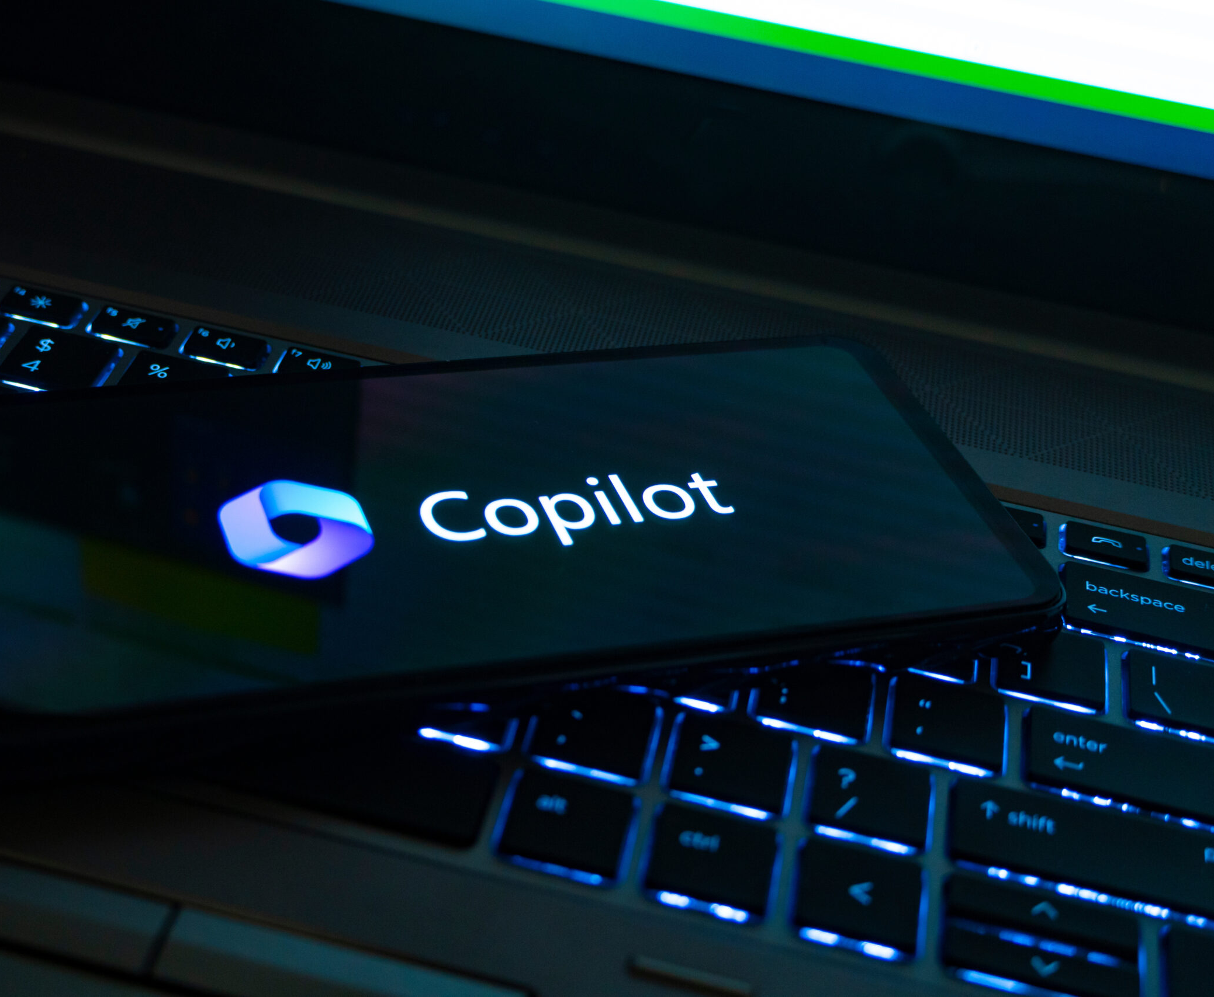
Getting to know Copilot
What is Copilot?
Commercial Data Protection
Protected Account Benefits
Protected Account Disadvantages
Using Copilot without Protection
This Photo by Unknown Author is licensed under CC BY-SA

Slide 5
What is Copilot?
Generative AI
Developed by OpenAI (Creators of OpenGPT)
Advanced Language Models
Answers questions
Provides information
Assists with writing, code, essays and more
Generates creative content
Works in many languages
This Photo by Unknown Author is licensed under CC BY-SA

Slide 6
Let’s play with Copilot!

Slide 7
What is Copilot?
Generative AI
Developed by OpenAI (Creators of OpenGPT)
Advanced Language Models
Answers questions
Provides information
Assists with writing, code, essays and more
Generates creative content
Works in many languages

Slide 8
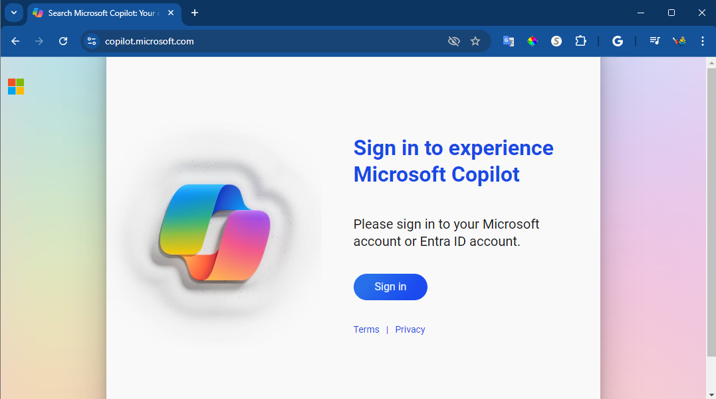
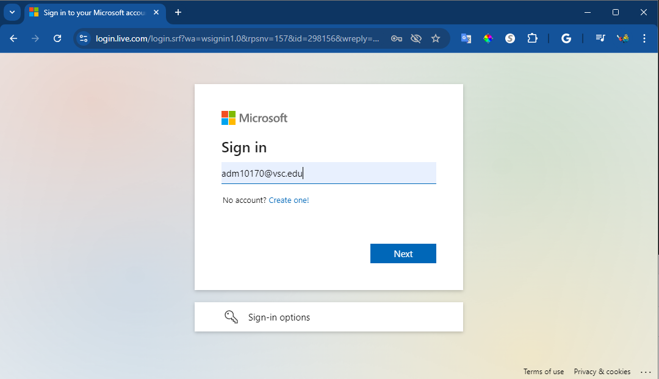
Sign Into Copilot
Open any browser
Enter copilot.Microsoft.com in address bar
Sign in with your college account
Notes:
Let’s do a basic look into Copilot in any browser. Open your browser and in the address bar enter copilot.Microsoft.com
Sign in using your college account as you would to sign into any Microsoft applications like Outlook – your username followed by @vsc.edu
You may need to also use Duo to give it permission.
[switch to Copilot in Chrome]
Let’s take a look at what Copilot looks like in our browser window.
In the top right you have the account you signed in with.
You have the Commercial Data Protection seal – which we’ll talk about a little more later
And there’s a little hamburger menu button that only does something if I’m in Edge – we’ll play with that in a bit
In the top left we can choose the Copilot or the Notebook interface. Take a look at the Notebook version and we see it’s just a plan text prompt and response area. We’ll go back to copilot.
At the bottom we have the ability to write our prompts here next to New topic and In the box where it says “Ask me anything…” Note we can attach a picture or a file or talk to it.
Above the prompt box we can choose a conversation style. There is not clear documentation on these, but rumor has it the “More Precise” uses the current highest paid version of ChatGPT. Except for writing poetry or creating images, I stick with “More Precise” and am generally happy.
Poetry? Yes! Poetry. Let’s make our first use of Copilot be to write a poem. You can make it in any style like a limerick or a sonnet and about any topic.
I’m going to write a limerick about learning about Generative Artificial Intelligence.
I’ll pick the More Creative button
Then I’ll tell it I want it to compose a Limerick about being a student of Artificial Intelligence. This is actually a good first prompt because I’ve defined the audience (I’m a student), a style of writing (Limerick), and a topic to write about.
+++++++
Please write me a limerick about being a student learning about Artificial Intelligence (AI)
That was good. Could you write a limerick about a student learning about Generative AI like Copilot?
rewrite that without using the phrase "day and night“
+++++++
We can improve our results, maybe, by clarifying as I just did.
Let’s go back to that home page by selecting New Topic.
Let’s look at some of these prompts that are illustrated in the middle of the screen. Let’s switch to More Precise
+++++++
Sort the world’s lakes in a table by size and location
+++++++
With more precise, Copilot rarely hallucinates sources and provides links to where it found the information on the current internet. I encourage students when they’re brainstorming any kind of research that this can be a good tool to help. Your mileage may vary.
Let’s try one more thing while we’re here in the general Copilot in a browser – let’s see if we can draw a picture.
++++++++++++
Draw me a picture that I can use as the background image on my title slide on a presentation related to learning the basics of Copilot, the Generative AI tool by Microsoft. It should be a dark theme style, not too much white, so it's easy on the eyes at the front of the room.
++++++++++++
[Talk about Designer, Powered by DALL-E3 and the 14 boosts you get per day with this licensed account.
Talk about other images made in the room, issues with text, etc.]

Slide 9
We played with Copilot!
Notes:
Before we move on to the Edge tools that are different than other browsers I’d love to hear any comments or questions.
[pause if no responses]
Anything more you want to explore when you get home?
Anything you learned that you’ll share?
This next bit

Slide 10
Accessing Microsoft Copilot Enterprise
Step 1
Best Practice: Open Edge Browser
Open Edge and sign in near top right with your collegeID@vsc.edu
Note: If you use Edge personally, make sure in the top left you are in your work account
Click on the Copilot icon in the very top right to open the Copilot panel in Edge OR click on the Copilot icon on the right of the search bar.
All other browsers:
Enter copilot.microsoft.com in the address bar of your browser
Sign in using your collegeID@vsc.edu
In the top right you should have the Protected seal
This VSCS-wide “private” version of ChatGPT and Dall-E enables faculty and staff to experiment with generative
AI text, image, and coding
tools without storing the
user’s login and chat or
allowing it to be used
to train the large
language
models.
Step 2
Pay close attention to this box above the prompt input.
Try to use “Creative” or “Precise” based on the nature
of your request to get the best work out of Copilot. Note: The panel in Edge allows you to work with the content of your browser window, not just what you put in the prompt box.
Notes:
This slide is one I made earlier this year to put the key points of using Copilot and Copilot in Edge. It makes for an easy handout or small poster if you want to put it in computer labs or a library or wherever.
The difference between Edge and other browsers is only that Edge offers the Copilot “panel”. This allows Copilot to work with the content of your browser window. This is especially good if you want it to read through a web-based PDF.
I’m going to switch to an Edge browser and work from there. [next slide]

Slide 11
Experiment & Share
Amy.moore@ccv.edu
Notes:
You will need to sign into Edge with your “work or school” account. If you don’t have that set up, you’ll do that here in the top left of the browser. You can have multiple school, work, or personal accounts. When setting this up make sure you pick Other profiles > Setup new work profile and follow the prompts.
Here in Edge, you can go to Copilot on the big browser page but clicking the Copilot icon on the right side of the Bing search bar.
But we can open the Copilot panel by clicking on the Copilot icon in the top right of the browser window when we’re signed in.
We still have the Chat and Compose tools
The X closes the panel
We can see the Commercial data protection shield (click on this and show group how to see what this does and how it works)
We don’t have the creative and precise buttons here, but we do have the prompt window here at the bottom with adding an image, a new “screen shot” tool, add a file, and talk to the chatbot.
What happens here is we can ask questions about the content of the browser window. For example, I could go to the New York Times.
+++++
Based on the content of this website, what are the key events and issues related to the 2024 US presidential election right now?
+++++
+++++
What is the longest article on the page based on the minutes it takes to read under each headline?
++++++
( I did not get the correct answer )
Pick an article and select the summary button. Look at additional proposed questions/clarifications/prompts
[Return to slide deck and ask for feedback, results, learning, questions]

Slide 12
Thank you
tinyurl.com/TLT24
Amy.moore@ccv.edu
Notes:
If you didn’t get a chance to download my handout, here’s the link you can enter into your browser.
I really appreciate you all and I will be doing a session after lunch which will go into some more things we can do with Copilot and other Generative AI tools like Gemini.

