Slide 1
Digital Accessibility for Learning 101
Annissa Stout, M.Ed.
EdPros – Alt Format Expert

Slide 2
Agenda
Assistive tech
What does ‘accessible’ mean
How to find documents
How to create documents
Accessible presentations
Q & A

Slide 3
Assistive technology
Screen reader
Text-to-speech
Used by blind/low vision individuals
Allows for navigation of their computer – reads everything
Used by individuals are sighted, but have a disability related to reading OR by auditory learners
Reads content only

Slide 4
Accessible Documents
To read or not to read… What is an accessible document? How can I tell?

Slide 5
Creating an accessible document
Headers
Use numbered lists
Descriptive links
Simple tables
Alt text for images
Avoid using color only to indicate important info
Avoid using textboxes

Slide 6
Creating documents Navigational structure
Headings
Numbered lists
Allow for easy navigation, both visually and for screen readers
Avoid editing the font and use the built in Styles
Use either the built-in numbering or bulleting lists to create proper structure.

Slide 7
Creating documents Descriptive information
Descriptive links
Use more than color
Allows users to know where they are going or what action will happen
Avoid “click here”, use meaningful language
Avoid using color only to convey information

Slide 8
Creating documents Accessible content
Simple tables
Alt text
Set a header row
Add alt text as needed
Avoid using tables to design your document layout
Textual description of images/charts/graphs
Keep descriptions specific and simple

Slide 9
PowerPoints
Present with style… accessibly!

Slide 10
PowerPoint tips
Apply same principles from creating documents
Simple tables
Descriptive links
Alt text for images

Slide 11
PowerPoint tips Structure
Use built in Slides
Avoid using textboxes
Need a specific layout? Use the Slide Master Tool to create it
Double check Reading Order

Slide 12
PowerPoint tips Presenting
Review in presentation mode!
Look at font size
Check for good color contrast
Read the text on the slide
Consider using PPTs built in Live captioning/subtitling

Slide 13
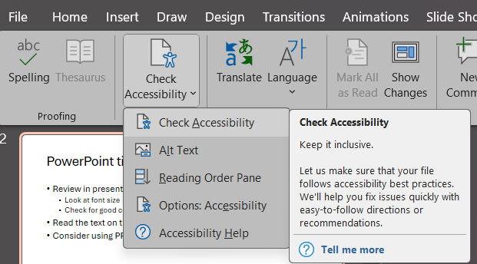
This is an example of an inaccessible slide
What do you think?
This is really bad right?

Slide 14
Final thoughts…
Always use the built-in tools/styles/layout as it will result in more accessible documents and less headaches for you
Accessibility feature you put in a Word document, will transfer to PDF
Use Microsoft’s and Adobe’s built in accessibility checkers to review your documents before posting

Slide 15
Q&A and Resources
Best practices for accessibility
Heading styles
Create simple tables
Input alt text for images
Slide Master Tool
Check Reading Order
Review slides in presentation mode
WebAIM: Color contrast checker

